Slide 1


Slide 2
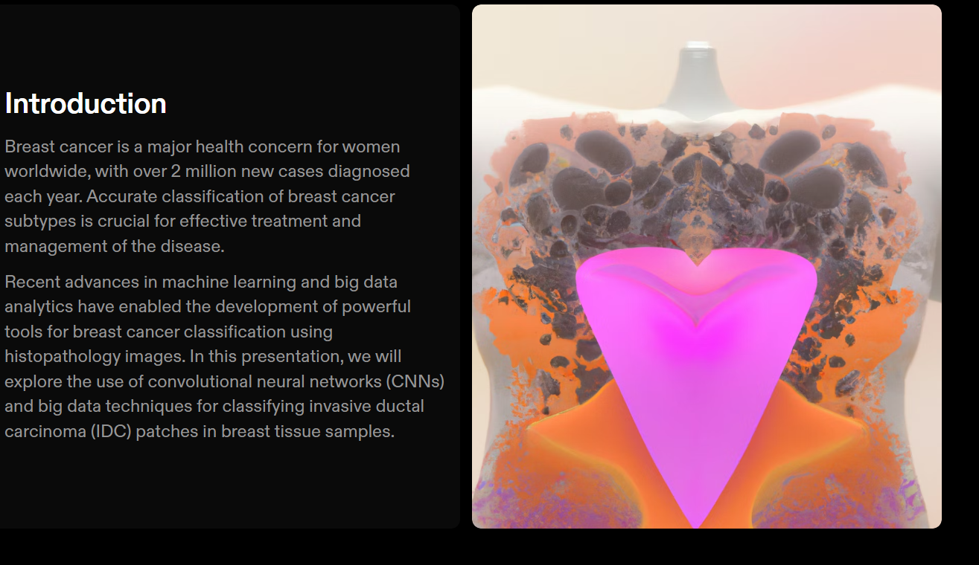

Slide 3
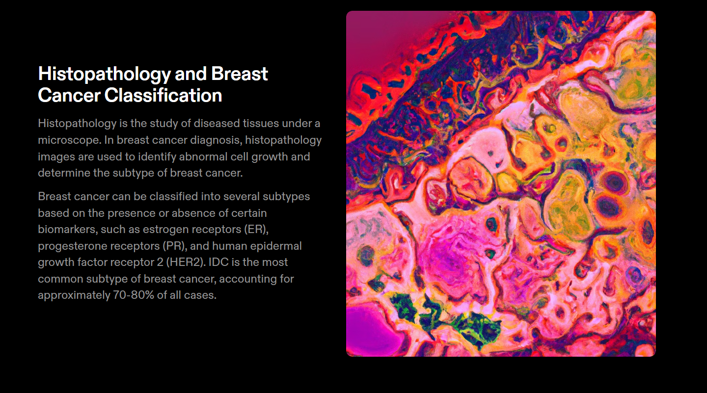

Slide 4
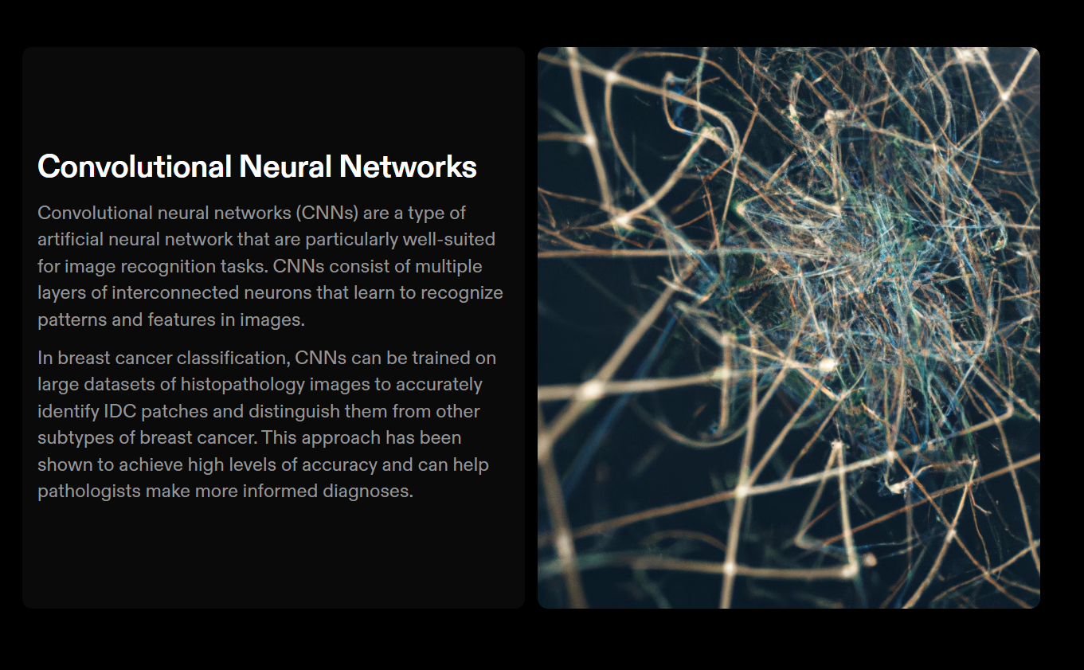

Slide 5
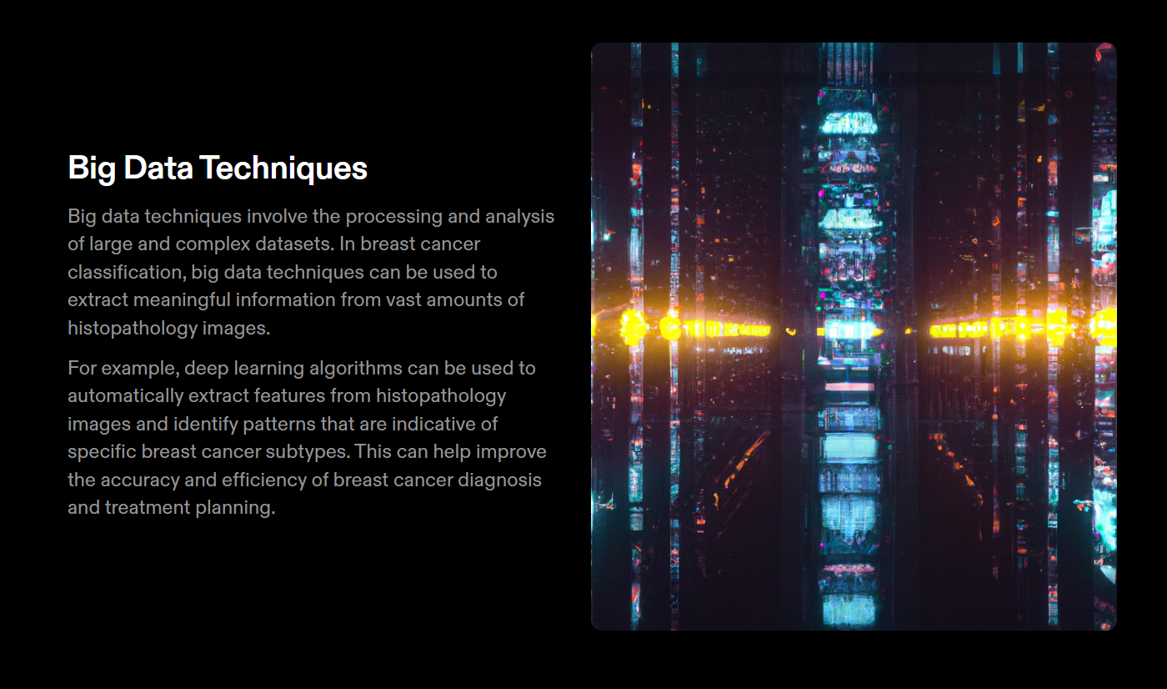

Slide 6
Problem Statement & Description Breast cancer is the most common form of cancer in women, and invasive ductal carcinoma (IDC) is the most common form of breast cancer. Accurately identifying and categorizing breast cancer subtypes is an important clinical task, and automated methods can be used to save time and reduce error. The goal of this script is to identify IDC when it is present in otherwise unlabeled histopathology images. The dataset consists of approximately five thousand 50x50 pixel RGB digital images of H&E-stained breast histopathology samples that are labeled as either IDC or non-IDC. These numpy arrays are small patches that were extracted from digital images of breast tissue samples.

Slide 7
Dataset description
The original dataset consisted of 162 whole mount slide images of Breast Cancer (BCa) specimens scanned at 40x. From that, 277,524 patches of size 50 x 50 were extracted (198,738 IDC negative and 78,786 IDC positive). Each patch’s file name is of the format: u_xX_yY_classC.png — > example 10253_idx5_x1351_y1101_class0.png . Where u is the patient ID (10253_idx5), X is the x-coordinate of where this patch was cropped from, Y is the y-coordinate of where this patch was cropped from, and C indicates the class where 0 is non-IDC and 1 is IDC.

Slide 8
